Slide 1
Cleansing Therapy
Cure Yourself
अपना इलाज अपने हाथ
By
Dr Piyush Saxena
Ph.D. Naturopathy (USA)

Slide 2
Declaration
I have experimented with nearly every recommendation on
myself, my father, mother, wife, son and daughter, and
reaffirmed their efficacy.

Slide 3
Declaration
I do not charge any fee.
I do not accept donations.
I do not promote products of any company.
I propagate Cleansing Therapy solely for
my personal satisfaction.

Slide 4
Cleansing Therapy
Self, leading to family happiness
Increased employee productivity
Progress of the country
A healthy heart
Improved health for:
(company policy)
A Liver Cleanse protects you from heart attack for at least six months by reducing cholesterol level in the arteries.

Slide 5
Keep it basic
To repair your car or scooter, do you go to a highly qualified automobile engineer or a roadside mechanic? Your choices are -
  A solution for Rs. 200, or
  A problem for Rs. 20,000
Information overload – The internet can overload you with tremendous amount of information about your problem. Sometimes this information can even contradict one another. For the same reason, highly educated MDs lack confidence in their judgement and suggest getting a second opinion.
You may choose to find solutions from the pile of information available online, or you may choose to Cure Yourself.

Slide 6
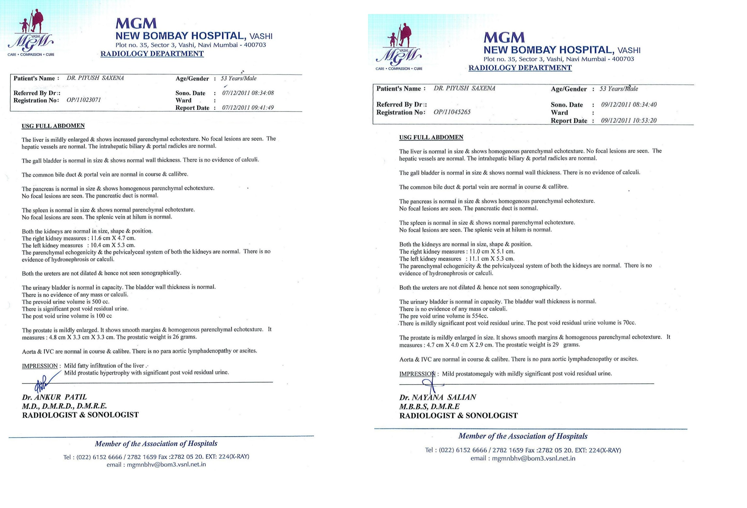

Slide 7
Comparison of Pathological examinations of Dr Piyush Saxena at MGM New Bombay Hospital Vashi
Registration No. | OP/11023071 | OP/11045265
Date | 07/12/2011 | 09/12/20011
Time | 08:34:08 | 08:34:40
Report
Liver | Mildly Enlarged, Increased parenchymal echo texture | Normal in size, Homogenous parenchymal echo texture
Right Kidney measures | 11.6 cm x 4.7 cm | 11.00 cm x 5.1 cm
Left Kidney measures | 10.4 cm x 5.3 cm | 11.1 cm x 5.3 cm
Prostate measure | 4.8 cm x 3.3 cm x 3.3 cm | 4.7 cm x 4.0 cm x 2.9 cm
Prostatic weight | 26 gms | 29 gms
Impression | Mild fatty infiltration of liver | No comments made
 | Mild prostatic hypertrophy | Mild prostatomegaly
Name of the Doctor | Dr. Ankur Patil M.D.,D.M.R.D., D.M.R.E Radiologist & Sonologist | Dr. Nayana Salian MBBS, D.M.R.E Radiologist & Sonologist

Slide 8
IS MIGHT ALWAYS RIGHT?
Cedars-Sinai Medical Center,
Los Angeles, USA
A team of 6 highly qualified cardiologists evaluate the ECG, 2D Echo and Angiography report of a 58-year old patient
They conclude that the patient has 72 hours to live
What is your opinion on:
The role of Pudin Hara, Isabgol and Neembu ka Achar?

Slide 9
Cleansing Therapy
Guiding Principles
Windows 95 was a cutting-edge software 24 years ago but has since been superseded by several newer versions of the operating software, the latest being Windows 10. But this too will be obsolete in no more than a couple of years.
Mercedes-Benz AMG GT-Roadster, the latest model in automotive engineering, costs a whopping Rs 2.40 crores. However, the car will be superseded by even better technologies in the next five years.
Our bodies have been designed by the world’s best engineer – Mother Nature. She not only made us ‘obsolescence proof’, but also provided our body with an incomparable quality to heal itself - something that no engineer or doctor has been able to replicate.

Slide 10
Cleansing Therapy
Facts
Women (55-60%) use Cleansing Therapy more often because preparation of ingredients takes time
The age group of prime users is between 25 – 65 years
Cleansing Therapy is not yet supported by solid research and data as compared to conventional medicine because medicinal research is primarily conducted by pharmaceutical companies for the promotion of their products that you buy.

Slide 11
About Cleansing Therapy
Cleansing Therapy is an alternative healing method. It is a compilation of various cleansing techniques propagated after years of research and successful trials.
Based on the concept of cleansing toxins from various parts of the body, Cleansing Therapy uses completely natural products, often found in our kitchens or local stores.
Cleansing Therapy does not claim to be a replacement for modern allopathic treatments, which are perhaps necessary in acute conditions, or for instant relief, pathology or surgery.

Slide 12
Awards,
Acceptance,
and
Recognition

Slide 13
Google Ad Grant
The Temple of Healing, a trust founded to promote the Cleansing Therapy, is recipient of a Google Ad Grants award worth US $10,000 per month.
As a result, our website appears among the top results on Google among nearly 8 lakhs sites.

Slide 14
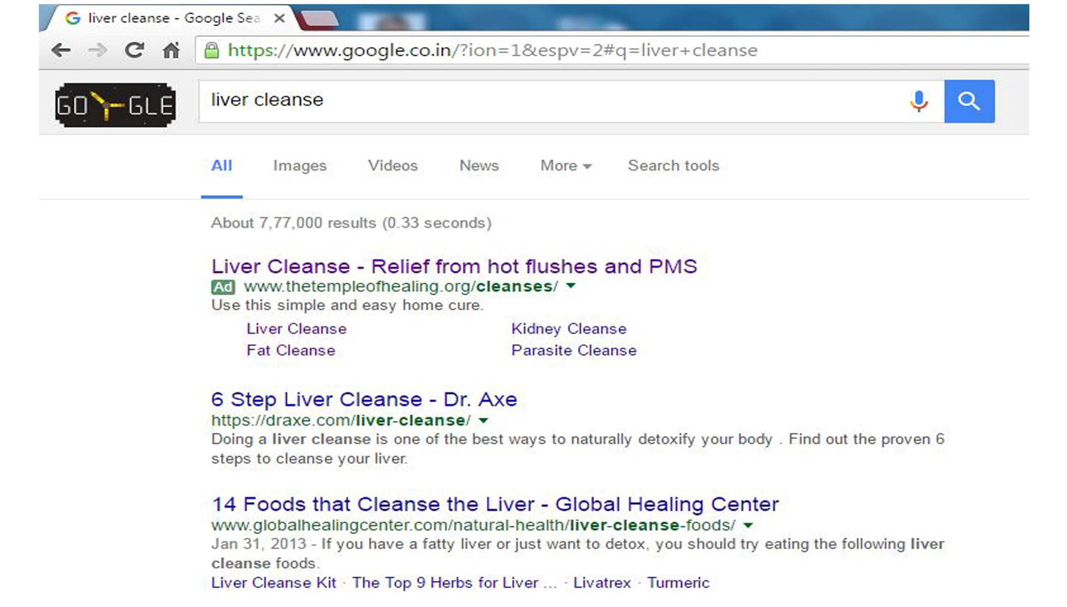

Slide 15
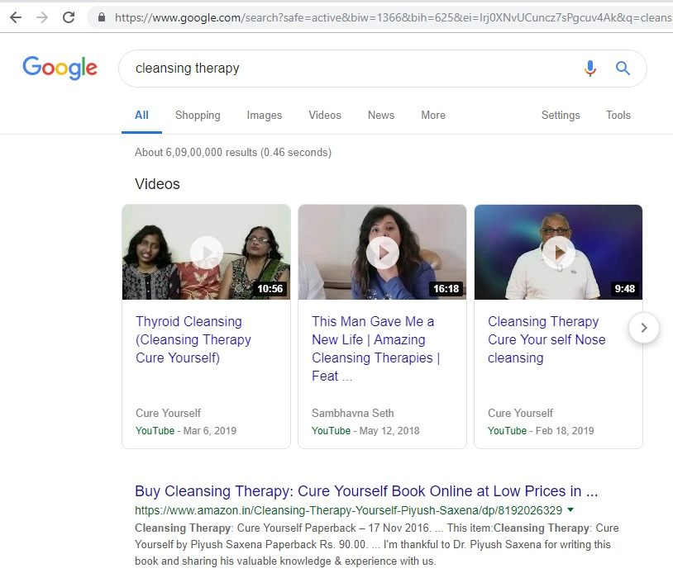
Growth of Cleansing Therapy in 5 years:
7 crore hits on Google as of Jan 01, 2020

Slide 16
Ministry of AYUSH
The Rajasthan Ayurved University, Jodhpur submitted a proposal on May 11, 2017 to AYUSH ministry for “the comparative, prospective and clinical study to evaluate the efficacy of Cleansing Therapy under the influence of Anu Pravan theory described in Ayurveda treatise,” requesting for a budgetary allocation of Rs 19.32 lacs for the study.

Slide 17
Recognition by Ministry of Health
In response to circular (V.25011/436/2016-HR) dated February 28, 2017, we submitted a proposal for recognition of Cleansing Therapy as an alternate means of treatment to the Department of Health Research (DHR), 1 Red Cross Road, Ministry of Health and Family Welfare, on March 27, 2019.
After a meeting held on May 27, 2019, the Ministry formulated certain criteria and advised us to submit more detailed information. We are currently doing the needful.
We have got an unofficial communication that the Ministry will soon invite us to give a presentation on Cleansing Therapy.

Slide 18
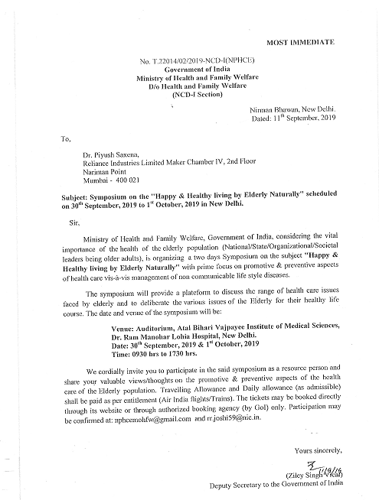

Slide 19
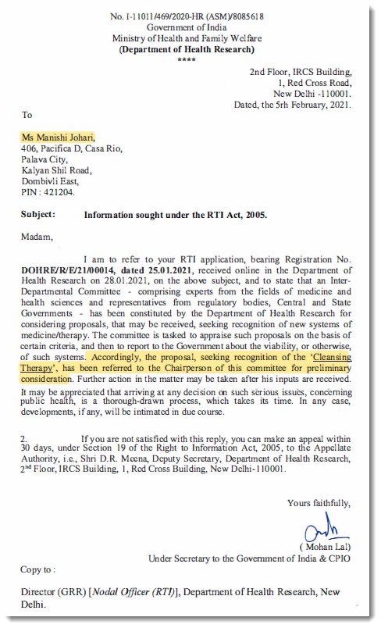

Slide 20
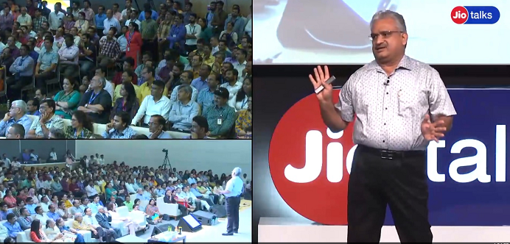
Jio Talk
June 27, 2019

Slide 21
Who needs a Cleanse?
Who is ill? Who is well?
Do you have the same energy level as you did 5 years ago?
If yes, then you do not need this treatment.
If no, then start your Liver Cleanse today.
Who is old and who is young?
Is it 100 years or 90, 80, 70, 60, 50 or 40 years?
But a 30-year old man tells his 20-year old brother that he is old!

Slide 22
Causes of sickness
Pollution in air, rapid urbanisation, concrete buildings, materialism and possessiveness (mother nature had recommended us to live in natural conditions without possessions), unhealthy food habits, stress caused due to fear of loss, irregular sleep cycles, etc. lead to accumulation of toxins in blood, intestine, kidney, liver, joints and other parts of the body, making us sick, very sick.

Slide 23
Cleansing Therapy can cure:
Acidity
Backache
Burns
Diabetes
Acne
Bed wetting
Calcium level
Diarrhea
Allergies
Bloating
Complexion
Ear infection
Anemia
Blood pressure
Depression
Fatigue
Anxiety
Body odour
Constipation
Fever
Arthritis
Bronchitis
Chronic sore throat
Frozen shoulder
Asthma
Breathing problems
Chronic cough/cold
Gall Bladder Stones
Anal Itching
Breast discomfort
Dental problems
Gout and knee pain

Slide 24
Cleansing Therapy can cure
Headache
Inflammation
Migraine
Pharyngitis
Hernia
Insomnia
Muscle pain
Pimples
Hot flashes
Joint pain
Osteoarthritis
Sinusitis
Impotence
Kidney Stones
Osteoporosis
Scalds
Indigestion
Leucorrhoea
Old Accident Pain
Piles
Infertility
Heart problems
Menstrual Cramps
Negative thinking
Old age disorders
Menopause Problems
Pre-menstrual Syndrome
Skin Problems
LDL Cholesterol reduction
Sleep irregularity
Irritable bowel syndrome

Slide 25
Cleansing Therapy can cure
Snoring
Spondylitis
Stress
Tiredness
Tonsillitis
Urinary tract infection
Uterine Fibroid
Vaginal disorders
Weight Loss
and many more…

Slide 26
Cleansing Therapy may NOT cure
Cancer
HIV / AIDS
Parkinson’s disease
Neurological disorders
Paralysis
Multiple sclerosis
However, it may help in reducing the symptoms

Slide 27
Core Strengths
My treatments are a combination of various traditional and modern therapies from around the world, including Unani, Naturopathy, Ayurveda, Holistic Healing and others, which I have modified to suit Indian conditions
Cleansing Therapy is completely safe and has no known or reported adverse side-effects even after several years of practice
These treatments can be practiced from the comfort of your home, do not need medical supervision, and are easy to follow

Slide 28
List of Cleanses
The following 12 cleanses are covered in my book, Cleansing Therapy
Kidney Cleanse (video available )
Acidity Cleanse
( -- do --)
Parasite Cleanse ( -- do --)
Liver Cleanse (Master Cleanse) ( -- do --)
Joint Cleanse
( -- do --)
Fat Cleanse
( -- do --)
Colon Cleanse
Mouth Cleanse
Ovary and PCOS Cleanse
Uterus & Fertility Cleanse
Fallopian Tube Cleanse
Vagina Cleanse

Slide 29
List of Cleanses
The following cleanses are available on my websites
Anger Cleanse
Breast Cleanse
Depression Cleanse
Ear Cleanse
Eye Cleanse
Hair Cleanse
Lung Cleanse
Nose Cleanse
Pancreas Cleanse
Prostrate Cleanse
Skin Cleanse
Throat Cleanse
Thyroid Cleanse
Tooth Cleanse
Virility Cleanse
Body Odour Cleanse
For details, visit
www.drpiyushsaxena.com or www.thetempleofhealing.org

Slide 30
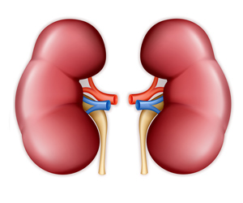
Kidneys
Kidneys are the primary organs that remove toxins. We have two kidneys located in the lumbar region, a little below the waist, oriented toward the back. Each kidney weighs nearly 150 gms and is about the size of an adult fist. They are bean-shaped and reddish brown in colour.
Each kidney has three regions - the cortex, the medulla and the renal pelvis. The outer layer, the cortex, contains nearly 12,00,000 filtering units called nephrons, each consisting of a glomerulus and a renal tubule.

Slide 31
Functions of Kidneys
Activation of Vitamin D absorption
Blood pressure regulation
Elimination of metabolic wastes
Maintaining acid-base balance (excretes alkaline salts)
Maintaining electrolyte balance
Maintaining fluid balance
Prostaglandin synthesis (the female body uses this hormone for the contraction of the womb during childbirth)
Stimulation of red blood cell production

Slide 32
Symptoms of a weak Kidney
Backache
Blood in urine
Changes in the frequency and quantity of urine passed
High/low blood pressure
Kidney/ureter stone
Pain in the kidney area
Pain or burning sensation while passing urine
Puffy, dark grey mess around the eyes, face, ankles and elsewhere on the skin
Tiredness, particularly in the evening

Slide 33
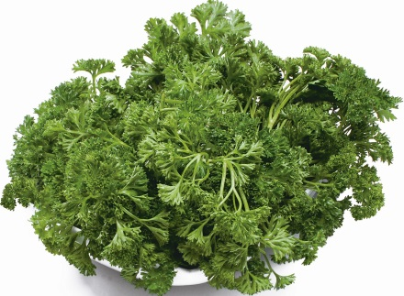
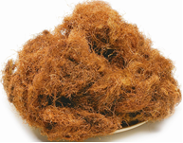
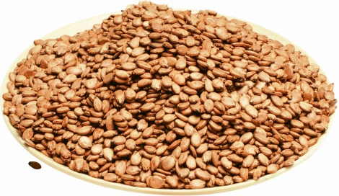

Kidney Cleanse - Ingredients
Parsley
Corn Silk (Dried)
Watermelon Seeds
Item | Quantity | Colour of Tea
Corn silk (fresh) | 500 grams | Dark brown
Corn silk (dried) | 50 grams | Dark brown
Parsley (fresh) | 500 grams | Green
Watermelon seeds | 100 grams | Brown
Coriander leaves | 500 grams | Green

Slide 34
Use Only Organically Grown Farm Ripe Corn Silk for Best Results
(खेत के पके भुट्टे के बाल)
98194 18648
97680 78628
88006 95356
93223 56008
90829 20289

Slide 35
Procedure and Doses
To make concentrated tea, fill the vessel/pot with just enough water to cover the ingredients and boil any of the three ingredients for 10 minutes.
Strain the water and keep it aside. Boil the residue again with fresh water for 10 minutes.
Strain it and add it to the water set aside in the previous step. Follow this procedure one more time or until the mixture begins to lose colour.
Let the strained mixture stand for a few minutes so that any sediment present sinks to the bottom of the vessel.
Carefully, without any sudden movement, pour the upper layer of the mixture into another vessel, until the sediment at the bottom starts flowing.
Drink one litre of this mixture 3-4 times or more during the day. The mixture must be stored in a refrigerator otherwise it will get spoiled. It can be stored in the refrigerator for a maximum of a day or two.

Slide 36
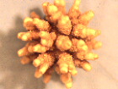
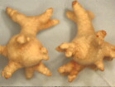
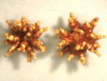
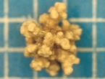
Kidney Stones
Gradually dissolved in the Kidney Cleanse process

Slide 37
Benefits
Dissolution of kidney stones
Fresh face and body, better skin tone with shining, fairer complexion, followed by gradual reduction in dark circles below the eyes
Higher energy and activity levels, and improved sleep quality
Improved haemoglobin levels in blood
Increased calcium levels (treatment of osteoporosis)
Old accumulated toxins expelled from the kidney, blood and body
Regulated blood pressure (marginally high or low BP are controlled)
Relief in backache and other body pain
For females, improvement in Pre-Menstrual Symptoms (PMS) and almost all gynecological problems
No more bed wetting and prostrate problems

Slide 38
Acidity
Acidity refers to a set of symptoms caused by an imbalance between the acid secreting mechanism of the stomach and proximal intestine, and the protective mechanisms that ensure their safety. The stomach normally secretes acids essential for the digestive process.
These acids help in breaking down food during digestion. When there is excess production of acids by the gastric glands of the stomach, it results in acidity. Nowadays, our lifestyle and dietary habits are such that they increase the acidity level of the body. Acidity is also responsible for dyspepsia, heartburn and the formation of ulcers (erosion of the lining of the stomach or intestines).
Acidity is measured in terms of pH. The lower the pH, the more acidic the solution and the higher the pH, the more alkaline; 7 being neutral.

Slide 39
Acidity Facts
pH of a neutral (neither acidic nor alkaline) element is 7
pH of the saliva of a newborn child 7.4, same as pH of blood
pH of the saliva of a person 30 yrs of age is 5.5
Sea water, spring, rivers and flowing water are alkaline
Chlorinated tap water and swimming pool water are acidic
Primarily, only raw green vegetables and fruits are alkaline, whereas, most other common foods that we eat are acidic
Nature recommends a diet of 20% acidic and 80% alkaline food. However, we normally eat 80% acidic and 20% alkaline food

Slide 40
Symptoms
Burning sensation in the stomach
Heartburn
Nausea
Dyspepsia
Burping
Lack of interest in foods
Sour blenching
Vomiting
Cough

Slide 41
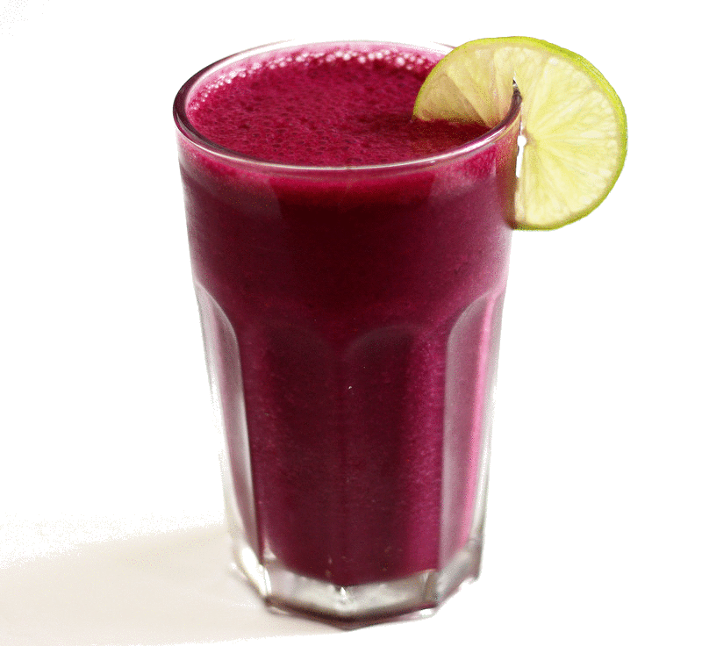
Acidity Cleanse through
green vegetable juices
Green vegetable juices, also known as detoxification drinks, have a powerful effect on the body's recuperative powers because of their rich, easily absorbed nutrients.
Fresh juices contain proteins, carbohydrates, chlorophyll, mineral electrolytes and healing aromatic oils. But most importantly, fresh green juice therapy makes available to every cell in our body large amounts of plant enzymes, an integral part of the healing and restoration process.

Slide 42
Green Vegetable Juice as Blood Tonic
The molecular composition of chlorophyll is so close to that of human hemoglobin that these drinks can act as "mini-transfusions" for the blood, and tonics for the brain and immune system.
They contain large amounts of vitamins C, B1, B2, B3, pantothenic acid, folic acid, carotene and choline. They are high in minerals, such as potassium, calcium, magnesium, iron, copper, phosphorus and manganese.
They are full of enzymes for digestion and assimilation, some containing over 1,000 of the known enzymes necessary for human cell response and growth. Green drinks also have anti-infective properties, carry off acid wastes, neutralize body pH and are excellent for mucous cleansing. They can help clear the skin, cleanse the kidneys, purify and replenish blood.
Formula of human blood (hemoglobin) - C₃₄H₃₂O₄N₄CIFe
Formula of plant blood (chlorophyll-b) - C₅₅H₇₂O₅ N₄Mg

Slide 43
How to make Green vegetable juice?
Only use clean and fresh vegetables. You may combine different vegetables in any proportion to suit the needs of your body and taste.
Do not mix fruits and vegetables while extracting the juice. Wash the vegetables, cut them into small pieces and put them in a juicer. Buy a juicer if you don't have one.
Meanwhile, you may use a mixer-cum-grinder. Strain this mixture through a coarse strainer with large holes, so that you get enough fibre. The large holes in the strainer allow medium and small pieces of fibre to flow with the juice.
Only large pieces, which you find difficult to swallow are strained. The residual green paste can be used in chapati flour. Drink it fresh, since it spoils quickly.
Do not use it beyond 1½ days, even if it has been stored in the fridge. For example, if you have prepared the juice today morning, you can use it only until evening of the next day.

Slide 44
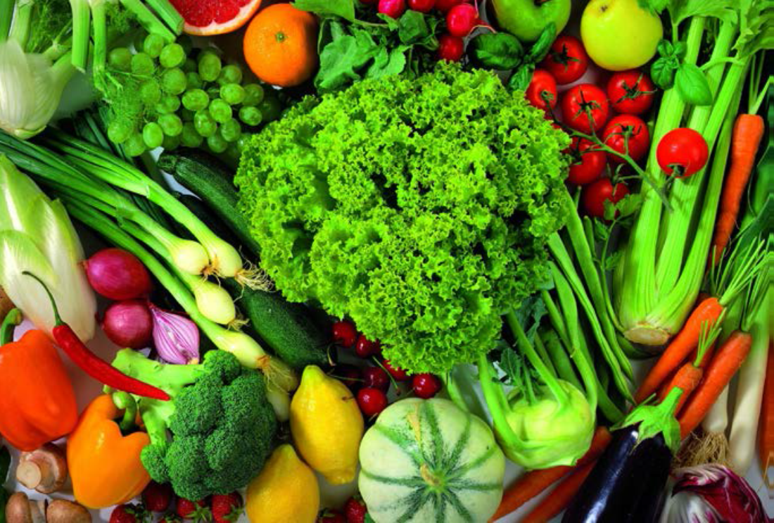
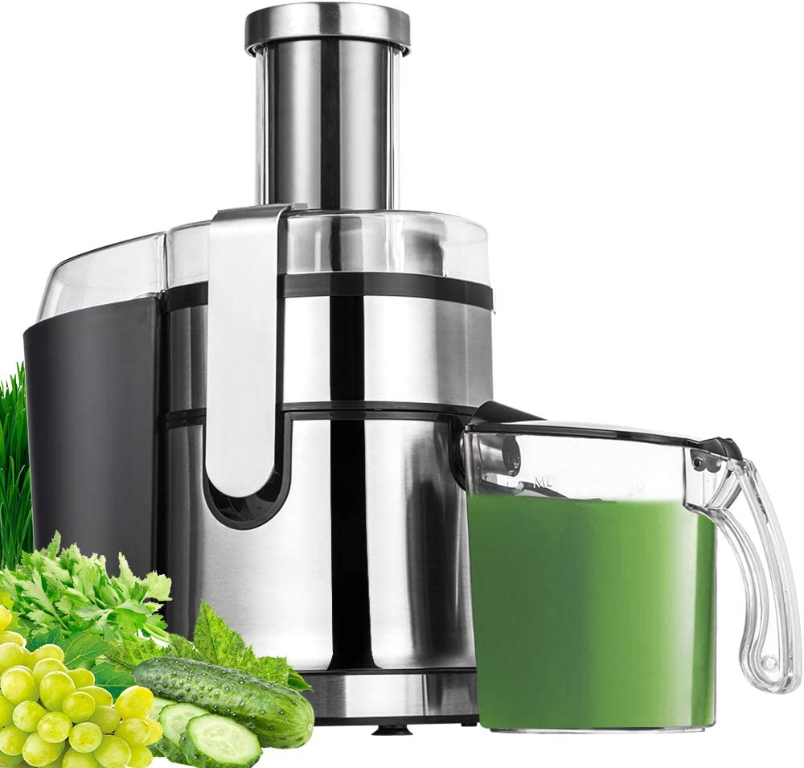
Vegetables for green juice
.
Mint
Beetroot
Bitter gourd
Bottle gourd
Cabbage
Capsicum
Carrot
Celery
Cucumber
Garlic
Ginger
Goose berry
Green
Tomato
Lemon
Parsley
Radish
Spinach
Turnip

Slide 45
Parasite
People often have parasites, such as roundworms, tapeworms, flatworms or microscopic protozoa, living inside their bodies.
All people suffer from parasites of one type or another in their lifetime
Parasites and unhealthy tissues are positively charged
3. Introducing a weak electric current (via the zapper) destroys parasites by reversing their polarity. Negatively charged ions are added to the body to encourage the diseased tissue to heal

Slide 46
Signs and symptoms
Anaemia or iron deficiency (pernicious anaemia)
Burning sensation in the stomach
Cutaneous ulcers, eczema, hives, itchy dermatitis, papilla Lesions, rashes, sores and swelling
Damp lips at night, dry during the day, grinding teeth while asleep.
Difficulty in gaining/losing weight, no matter what you do or eat
Digestive problems (gas, bloating, constipation or diarrhea that come and go, but never really clear up)
Eating more than normal but still feeling hungry
Fast heartbeat, chest pains and pain in the navel
Food sensitivities and environmental intolerance
Gastrointestinal problems and bulky stool with excess fat
Itchy anus, ears, groin, nose, penis or vagina
Joint and muscle pains with inflammation, often assumed to be arthritis, etc.

Slide 47
Tools for Parasite Cleanse
Clarkia tincture
Clarkia is composed of water, grain alcohol (nearly 37%) and an alcohol extract of three herbs - black walnut, wormwood and cloves. When consumed orally, it kills parasites in the digestive system.
Zapper
It introduces a weak electric current to destroy the parasites inside the body. Viruses and fungi inside cells, parasites in cysts and parasites with exoskeletons (like hookworms in the peripheral tissues) will take longer to kill.
Pulsar
It uses high intensity, short duration square wave to immobilize parasites. It treats the lymph system, head, stomach and intestine. It also reaches organs or areas that remain unaffected by the zapper.
Colloidal silver
Colloidal silver is a powerful, natural antibiotic that prevents infections. It acts as a catalyst and disables enzymes that the microscopic one-celled bacteria, viruses and fungi need for oxygen metabolism.

Slide 48
Parasite Cleanse using Clarkia
As Clarkia is a tincture, it can be used either orally or as an enema. You should have 12-15 drops of Clarkia three times a day for two weeks. Try having Clarkia on an empty stomach for best results
I have used Clarkia drops on an empty stomach, 12-15 drops three times a day, on the tongue (without water) for one week, along with using pulsar and zapper, besides drinking colloidal silver water twice a day, followed by a Liver Cleanse once in six months and found them to be very effective
One small Clarkia bottle has 1000 measured drops (60 ml). It is enough for one round of treatment of two patients for two weeks

Slide 49
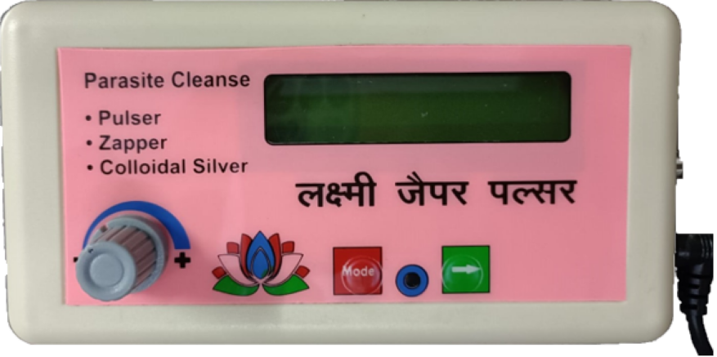
Parasite Cleanse using Zapper
The zapper current, at the specified voltage and frequency, stuns the pathogen and disrupts its hiding abilities.
Once discovered, white blood cells single them out as foreign objects. This enables the body’s immune system to identify and eliminate the pathogens, including parasites, bacteria and most viruses.
It happens quickly, in about an hour. The white blood cells then proceed to surround the dead invaders and they are removed from the body via urine and/or stool.
https://www.thetempleofhealing.org/laxmi-zapper-plus

Slide 50
How to Zap?
You will need two small pieces of cloth. Moisten them with salted water. Salted water is used to improve electric conductivity. Unsalted water will not conduct the weak electric current generated by the zapper into your body.
Power the zapper either using a power source or battery
Make salt-water solution by adding a teaspoon of salt to water
Place paper towels, sponge (or cloth) wetted with salt-water solution, around the copper pipes
Turn the power of your zapper on
Grasp the copper pipes, one in each hand, and hold them firmly
Hold them for seven minutes
Do the second zapping for another seven minutes (reverse the copper pipes by switching hands)
Disconnect the zapper and wait for another seven minutes
Do the third zapping again for seven minutes, at a changed frequency
Do the last and fourth zapping at a changed frequency, by switching pipes in both hands
Repeat it three times every day for seven days

Slide 51
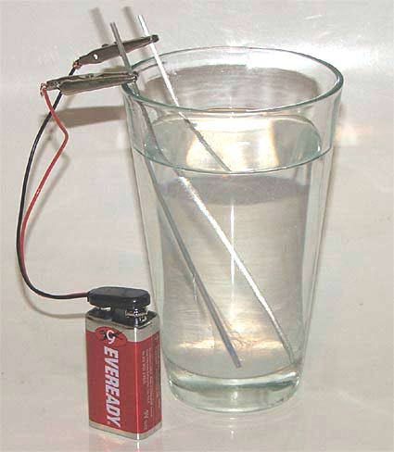
Parasite Cleanse using Colloidal Silver
Colloidal silver, when near a virus, fungus, bacteria or any other single celled pathogen, disables its oxygen metabolism enzyme, via the oligodynamic effect, by inhibiting the expression of enzymes and other proteins essential for ATP (Adenosine Tri-Phosphate) production.
Within a few minutes, the pathogen dies and is cleared out of the body by the immune, lymphatic and other elimination systems.
One to four teaspoons per day is generally considered to be safe for extended periods of time. It is recommended to consume 50 ml of colloidal silver water daily for four days, to establish a level and thereafter, 20 ml daily for maintenance (to be adjusted according to body weight for children). After six weeks, you may take a break for a few weeks.

Slide 52
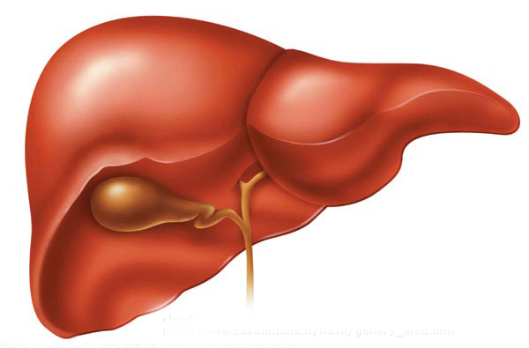
Liver Structure
The liver is the second largest organ (after skin) in the body, weighing nearly two kgs in an adult. The size of the liver corresponds with the size of the human body.
The liver is situated in the upper abdomen on the right side, beneath (and loosely attached to) the diaphragm. It is nearly 21-22 cms across at its widest point, 15-17 cms at its greatest vertical height and 10-12 cms across front and back.
The liver is composed of soft, red brown tissues, divided into lobes and enclosed by a tough fibrous capsule.

Slide 53
Functions
Liver is the chemical factory of the body
Liver produces bile
Liver processes all food
It incorporates amino acids into proteins
It is instrumental in clearing out harmful drugs and other chemicals from the body

Slide 54
Symptoms of Liver/Gallbladder problems
Cramping and gas in the stomach or intestine
Abdominal pain, which could transmit to the right shoulder
If a gallstone remains lodged in the bile duct for a long time, there will be a build-up of bile behind it. This can result in obstructive jaundice
Cholecystitis, an inflammation and possible infection in the gall bladder due to high levels of cholesterol

Slide 55
Why do a Liver Cleanse?
Due to eating cooked food, toxins accumulate in capillaries of the liver, as a result these capillaries start functioning like a hose pipe full of marble stones
Liver gets clogged and causes allergy
Liver Cleanse gives relief to patients suffering from diabetes resulting from inflammation and destruction of insulin secreting cells of pancreas
Asthma patients will find a lot of relief as well
A healthy person needs 2 cleanses per year to compensate for wrong food habits and polluted environment

Slide 56
Why do a Liver Cleanse?
Coronary artery
before the cleanse
Coronary artery
after the cleanse
LDL
cholesterol
Artery free
of LDL
cholesterol
A Liver Cleanse protects you from heart attack for at least six months, by reducing cholesterol levels in the arteries.

Slide 57
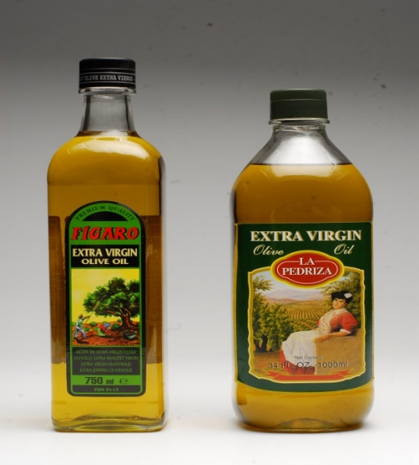
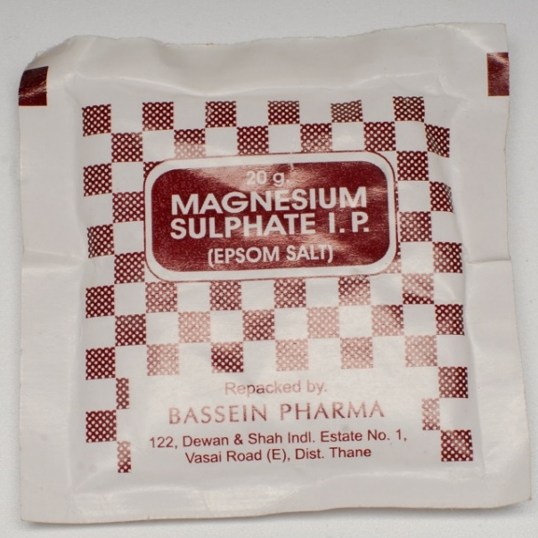
Ingredients
Extra Virgin Olive Oil
Available at food section of any shopping mall at Rs.320
Epsom Salt
Available at chemist at
Rs.28 for 4 sachets
Get 4 sachets of Epsom salt (MgSO₄.7H₂O), 20 gms each, 250 ml of extra virgin olive oil, 250 ml of orange, sweet lime (Mosambi) or similar juice. Tetra pack juices can also be used.

Slide 58
Schedule
  2 pm – No food afterwards. Dissolve 4 sachets of Epsom salt in approximately 800 ml of water and keep it in refrigerator
  6 pm – Drink the first dose of Epsom salt (about 200 ml)
  8 pm – Drink the second dose of Epsom salt as above
  10 pm – Drink a mixture of 175 ml Extra Virgin Olive Oil, mixed with nearly 175 ml of orange, sweet lime (Mosambi) or similar juice
  Next day, 6 am – Drink the third dose of Epsom salt
  8 am – Drink mixture of 75 ml of Extra Virgin Olive Oil, combined with juice
  10 am – Drink the fourth dose of Epsom salt

Slide 59
Use Extra Virgin Olive Oil
Only the Original Packing from Italy/Spain
Do NOT use Extra Virgin Olive Oil
Repacked in India

Slide 60
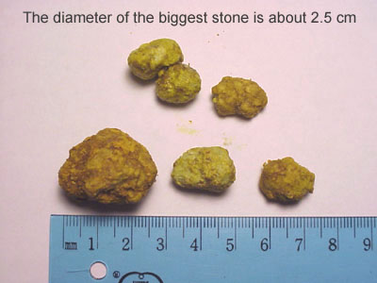
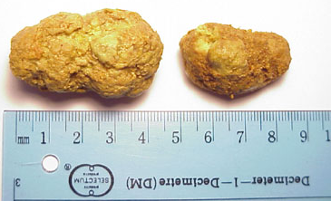
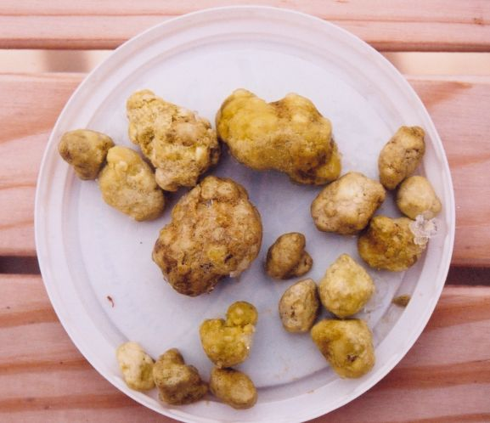
Liver/Gallbladder stones
passed out during cleanse

Slide 61
Joint Cleanse
Apple Cider Vinegar
Honey
Black Molasses

Slide 62
Thyroid Cleanse
Ashwagandha
Ginger
Lemon
Coriander leaf
Carrot
Cucumber

Slide 63
Fat Cleanse
hCG
Only for Career
Marriage
It relapses

Slide 64
Gyneac Cleanses
The shedding of the uterine lining and blood during periods is a regular monthly process among females.
Sometimes, a woman needs to take -
  A tablet to postpone periods, and/or,
  Oral contraceptive pills
These affect her natural cycles. When the uterine lining is not shed completely, the next cycle causes the new lining to develop over the old lining.

Slide 65
Ovary & PCOS Cleanse
Make curd from milk and add 10-15 gms of cinnamon to milk.
Alternatively add 10=15 gms of cinnamon sticks in half a glass (plastic or steel) of water. Put it in a freezer for 5-10 hours so that the water turns to ice. Take the glass out and let the ice melt. Drink the water and chew the cinnamon and spit it out when it becomes flavorless.
Lunaception: Sleep in complete darkness except for three nights in each cycle, i.e., on the fourteenth, fifteenth and sixteenth day, when you can use a dim light.

Slide 66
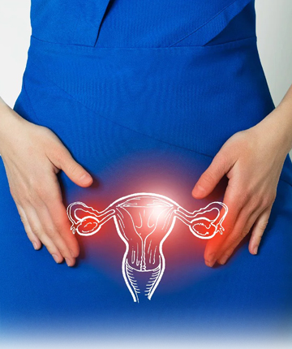
Fallopian Tube Cleanse
Self fertility massage is a series of massage techniques that support the health of fallopian tubes, thus improving the reproductive health.
Ovary massage helps draw oxygenated blood to your ovaries, thus improving the overall health of fallopian tubes.

Slide 67
Uterus & Fertility Cleanse
Add four tablespoons of dried marigold petals in 250 ml of boiling water and let it steep for 15 to 20 minutes, or,
  Fill a glass jar with fresh petals and add enough water so it fills the jar. Cap the jar and keep it out in the sun for 5-6 hours.
  Drink the water when it cools down.
Castor Oil: Use a castor oil pack on the lower abdomen for best results.

Slide 68
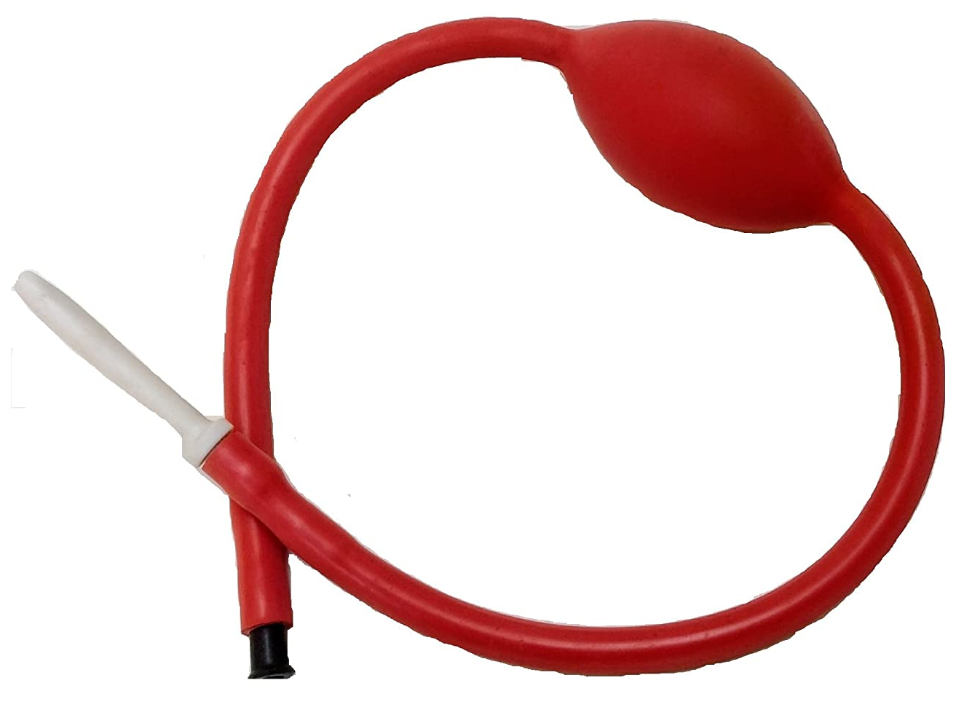
Vagina Cleanse
For many types of UTI related issues use Vaginal Douche

Slide 69
Conceive naturally
If there are no major abnormalities in the reproduction pathology reports of the couple, then Cleansing Therapy guarantees a natural conception in 100 days!

Slide 70
Homologous
.
Organs similar in position, structure, and evolutionary origin but not necessarily in function

Slide 71
.
Indifferent | Male | Female
Gonad | Testis | Ovary
Mullerian duct | Appendix testis | Fallopian tubes
Mullerian duct | Prostatic utricle | Uterus, upper vagina
Mesonephric tubules | Efferent ducts, Paradidymis | Epoophoron, Paroöphoron
Wolffian duct | Rete testis | Rete ovarii
Wolffian duct | Epididymis | Gartner's duct
Wolffian duct | Vas deferens
Wolffian duct | Seminal vesicle
Urogenital sinus | Prostate | Skene's glands
Urogenital sinus | Bladder, urethra | Bladder, urethra, lower vagina
Urogenital sinus | Cowper's or Bulbourethral gland | Bartholin's gland
Labioscrotal folds | Scrotum | Labia majora
Urogenital folds | Spongy urethra | Labia minora
Genital tubercle | Penis | Clitoris
Genital tubercle | Bulb of penis | Vestibular bulbs
Genital tubercle | Glans penis | Clitoral glans
Genital tubercle | Crus of penis | Clitoral crura
Prepuce | Foreskin | Clitoral hood
Peritoneum | Processus vaginalis | Canal of Nuck
Gubernaculum | Gubernaculum testis | Round ligament of uterus

Slide 72
Contact us
Visit our websites -
www.drpiyushsaxena.com
www.thetempleofhealing.org
Email: cureyourselfindia@gmail.com
Dr Mrs Manishi Johari, 9819418648
Email: manishi_vsj@yahoo.co.in
Mr Santosh Keshri – 8369045838/ 8976884903
Email: santoshnkeshri@gmail.com

Slide 73
Your future happiness
Now I look forward to all of you completing your Liver Cleanse in the
next 3 days!
खाओ, पियो, मस्त रहो...क्लीन्ज़ करो स्वस्थ रहो!

Slide 74

खाओ पियो मस्त रहो!
क्लींज करो स्वस्थ रहो!!

